Slide 1
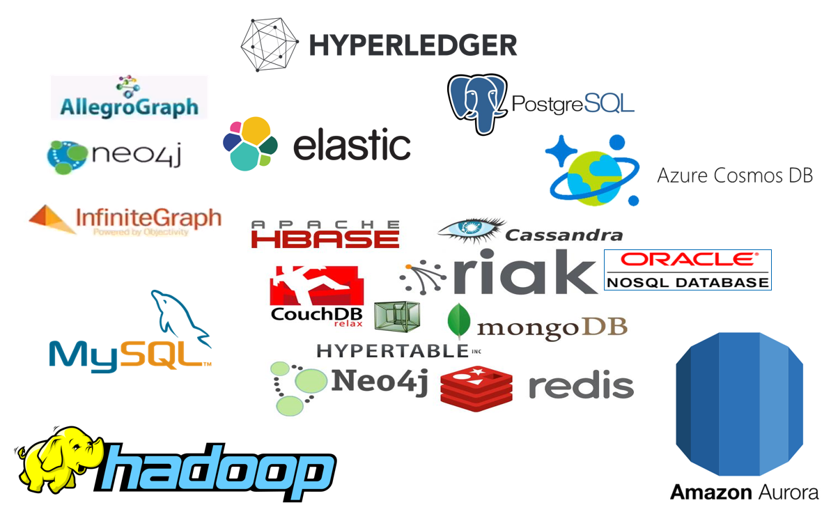







Introducing Apache Kafka – Part Three The Event Fabric tying everything together
µ
µ
Three Part Online Meetup - 22 april 2020
Lucas Jellema, CTO & Architect AMIS | Conclusion

Slide 2






Welcome
http://etc.ch/QmfH

Slide 3
Overview – Part Three
What is Apache Kafka? Core concepts and technology
Lab 1 – First hands-on with Apache Kafka
Programming
Brief introduction of Node (JS)
Lab 2 – Programmatic interaction with Apache Kafka
The Eneco Case – The Event Streaming Platform
Shades of Data – Streaming, CQRS, Event Sourcing
Lab 3 – DIY CQRS
Microservices and the quest for decoupling
Lab 4 – Microservices Interaction and Choreography
But wait – there is more:
Ecosystem and supporting tools
Alternative offerings (public cloud and stand-alone)
Part One
Part Two
Part Three

Slide 4

Final Demo
Microservices
Microservice

Slide 5
Microservice Objectives
Business Agility in functionality:
Quick and flexible, cheap, effortless and risk free
Develop/evolve
At scale (teams)
Agile
Innovative technology
Quick ramp up (new team members)
Manage
Agile (quick, automated, reliable rollout)
Scalable (scale-out horizontably, pay per usage)
Reliable and Resilient
Physically distributed
Robust (if one part fails, not everything is dragged down)

Slide 6
What is IT all about?
Production Runtime
Application

Slide 7
What is IT all about?
Production Runtime
Application
Business value
Platform

Slide 8
What is IT all about?
Production Runtime
Operations
Monitoring & Management
Application
Platform
Platform
Platform

Slide 9
Production Runtime is the Result of Preparation Runtime
Preparation Runtime
Production Runtime
Development
Operations
Monitoring & Management
Application
Application
Agile Design, Build, Test
Platform
Platform
CD

Slide 10
One team has Agile responsibility through full lifecyle
Preparation Runtime
Production Runtime
Development
Operations
Monitoring & Management
Application
Application
Agile Design, Build, Test
Platform
Platform
CD

Slide 11
One team has Agile responsibility through full lifecyle
Preparation Runtime
Production Runtime
DevOps
Development
Operations
Monitoring & Management
Application
Application
Agile Design, Build, Test
Platform
Platform
CD
You build it, you run it, you fix it, you evolve

Slide 12
One team has Agile responsibility through full lifecyle
DevOps
Application
Application
Platform
Platform
You build it, you run it, you fix it, you evolve

Slide 13
A microservice is owned by one team through its full lifecyle
DevOps
Microservice
You build it, you run it, you fix it, you evolve

Slide 14
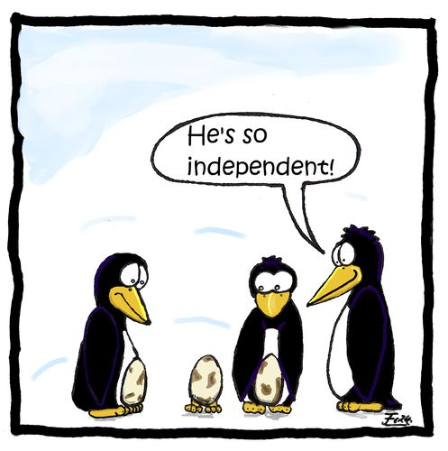

Microservices
Agile | Flexible | Scalable | (Re)Deployable
Independent | Decoupled | Isolated
Have their own private bounded context – the data they require to function
Their lifeblood
Communicate asynchronously, via events

Slide 15
The Microservice
HTTP REST/JSON
API
µ

Slide 16
Extended API of microservice
API
Deployment Interface
Injectable dependencies – reference to cache, logging, storage URL, …
Configurable meta-data – run time parameters, log level, credential (key)
Runtime Interaction Interface
REST API Resources & Operations – query and URL parameters, message formats
Events Consumed – alternative way to call | activate a microservice
Reference to entry in Event Catalog
May include reference to shared Cache Resource
Events Produced – alternative output from microservice
Event can be an asynchronous response to a stateless consumer

Slide 17
Microservices State
Generic Platform for running microservices
LDAP
Big Data
Block Storage
Cache
RDBMS
NoSQL
Document Store
Event Hub
Notes:
All data stores are distributed
Or at least distributedly available
They can be local or on cloud (latency is important)
Data in generic data store is still owned by only one microservice – no one can touch it
Only in DWH and BigData do we deliberately take copies of data and disown them

Slide 18
Bounded context of microservices
A micoservice needs to be able to run independently
It needs to contain & own all data required to run
It cannot depend on other microservices
UI
API
Customer
API
Order
CustomerModified event

Slide 19




Maintaining Derived Data in Bounded Context using Data Change Events communicated cross cloud over Kafka
Customer Microservice
Order Microservice
Customer Modified Event
Application
Application
Event Hub
Customers
Topic
DBaaS

Slide 20
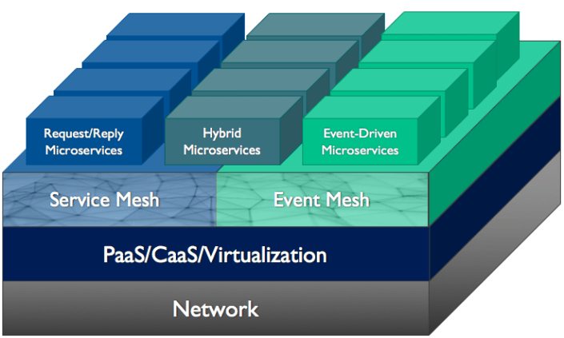
Event Mesh to complement Service Mesh
A network of interconnected event brokers that can be deployed in any cloud, PaaS or
Provides dynamic distribution of events so that event consumers can receive events from any event producer, no matter where the producer and consumer are attached to the mesh, without the need for configuration of event routing

Slide 21
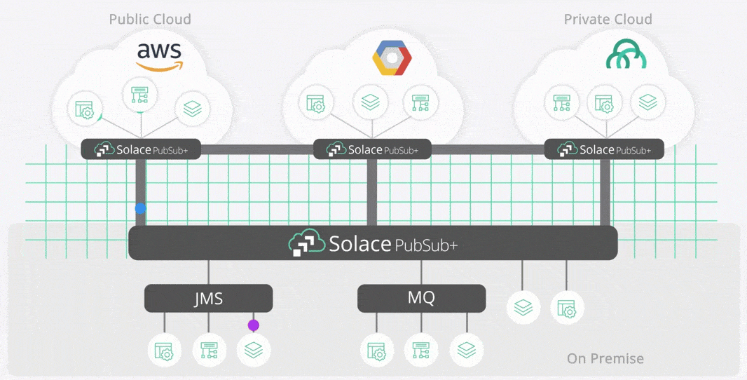
Event Mesh to complement Service Mesh

Slide 22
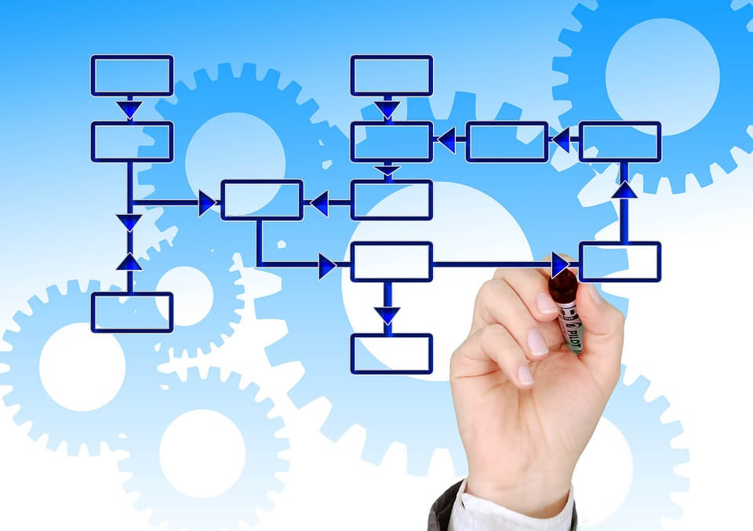
Workflow and Choreography
Business processes frequently require contributions from more than one microservice – executing a workflow in some form of collaboration
These microservices
are unaware of each other
potentially run multiple instances
can be unavailable
have their own transaction management
execute in a stateless fashion (no session)

Slide 23
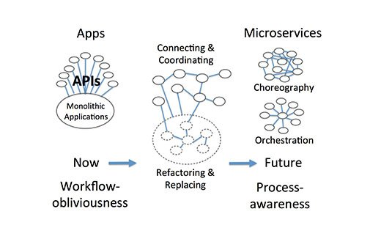
Approaches
Orchestration
Choreography
Hybrid
Coordinated | Facilitated Choreography
Mixing orchestration and choreography

Slide 24





Collaboration on Microservice Terms
Leverage Events
For triggering a microservice into action as part of the execution of a workflow instance
For signalling the completion of a task by a microservice
For decoupled (socially distanced) communication between microservices
Have a central store for managing the state of the workflow instance
Design for
horizontal scale out (multiple instances of microservices)
lack of session (full and instant amnesia in microservices)
distribution across premises (cloud, geograhic locations)
long running, high peaking traffic
Take a look at Zeebe, Conductor, Camunda, Cadence, AWS Step Functions

Slide 25
Asynchronous conversation between microservices
Put asynchronous request as a message on an Event Topic
This message contains a ‘correlation id’
µ A
µ A
µ A
µ B
µ A
3
5
1
questions
6
4
2
answers
Put response as a message on an Event Topic
This message contains the same ‘correlation id’ as the request contained
Retrieve original context based on the correlation identifier
Store current context associated with the correlation identifier

Slide 26
Overview
What is Apache Kafka? Core concepts and technology
Lab 1 – First hands-on with Apache Kafka
Programming against Apache Kafka
Brief introduction of Node (JS)
Lab 2 – Programmatic interaction with Apache Kafka
Shades of Data – Streaming, CQRS, Event Sourcing
The Eneco Case – The Event Streaming Platform
Lab 3 – DIY CQRS
Microservices and the quest for decoupling social distancing
Lab 4 – Microservices Interaction and Choreography
But wait – there is more:
Ecosystem and supporting tools
Alternative offerings (public cloud and stand-alone)

Slide 27
Apache Kafka is more than the core distributed event platform And there is more to distributed event platforms than Kafka
Apache Kafka is surrounded by an ecosystem
Primary supporting company: Confluent
Extensions, Tools, Enterprise Edition
Supporting resources (books, articles, tutorials, conferences)
Partner companies
Managed cloud services
Kafka-compatible Public Cloud offerings
Kafka-like offerings
Competitors, imitators, wannabees, lookalikes, …

Slide 28
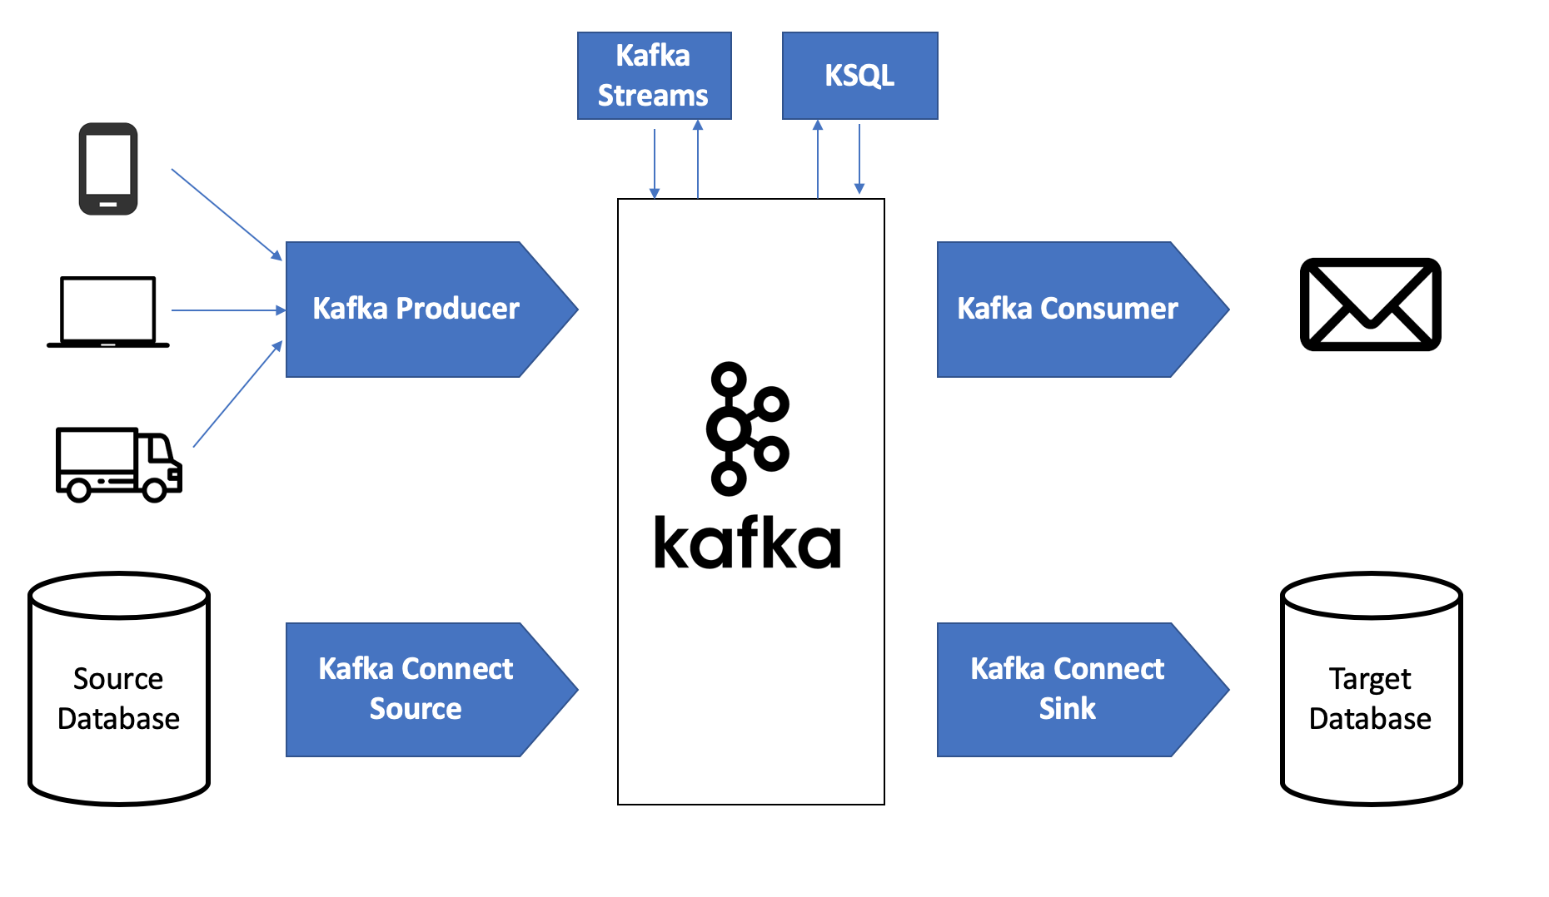
Ecosystem – Kafka and Friends
Kafka Schema Registry – manage message schema definitions
Kafka Connect – read data/capture change events from many sources and/or write to many targets
Also see Debezium
Kafka Streams
Kafka KSQL
Confluent Enterprise
Enterprise Grade Security
Replicator (synch across regions)
Ops (Operations) support
Confluent Managed Kafka Cloud Offering
Strimzi – Kafka on Kubernetes

Slide 29
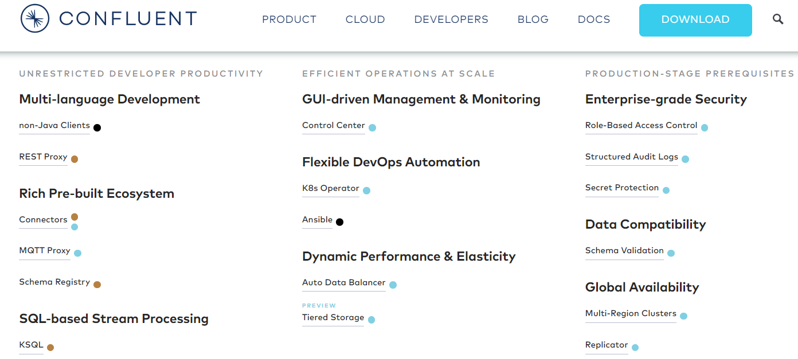
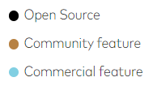
Confluent offerings

Slide 30

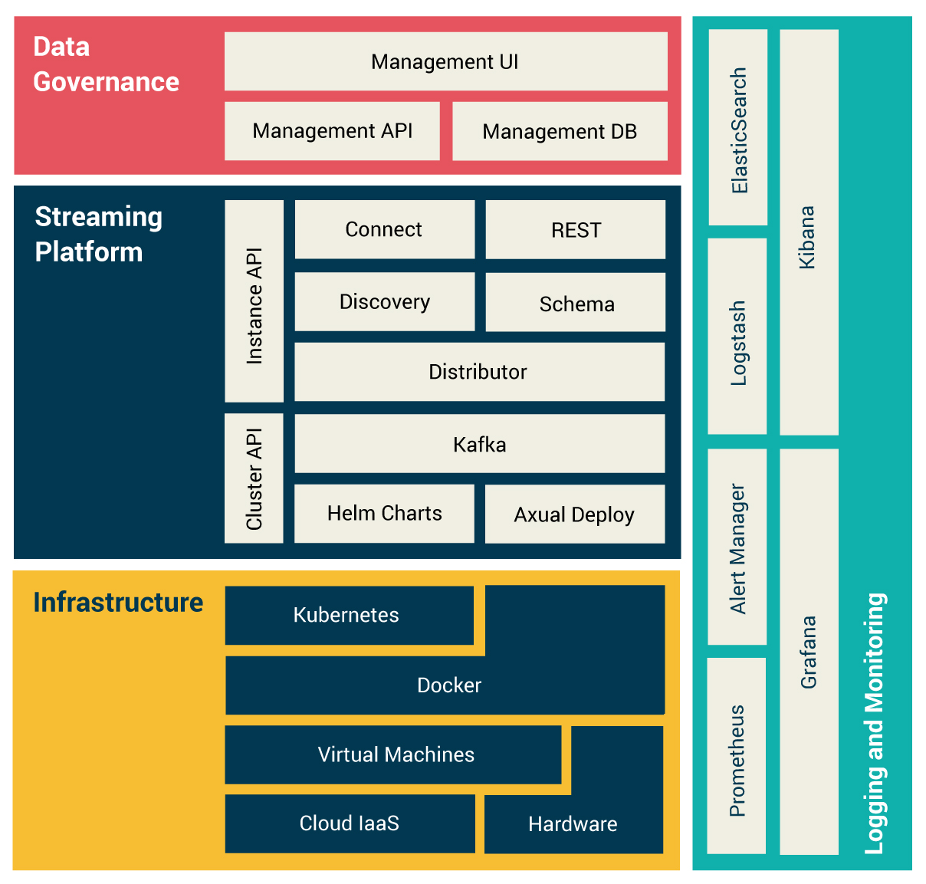
Axual Platform – makes Apache Kafka manageable
Self-Service Data Governance for Streams:
streams (topics), applications and their owners are registered centrally, governed decentrally by your DevOps teams
Data synchronization:
scale your streaming platform securely across multiple clusters, in on-prem or cloud clusters, or in a hybrid setup. Seamless to your connecting apps.
Stream namespacing: organize your streams based on tenant or environment, supporting the lifecycle of connecting applications
Schema Governance: assign schemas to be used by your data streams
100% compatible with Apache Kafka™️

Slide 31
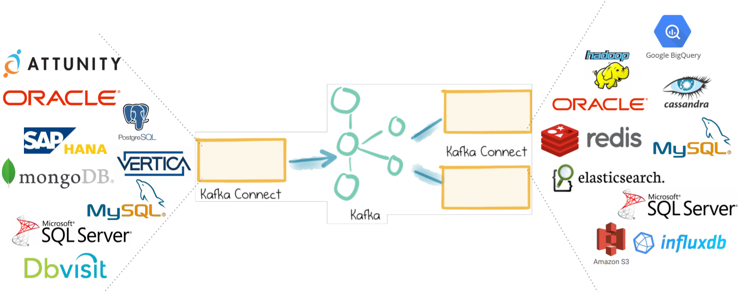
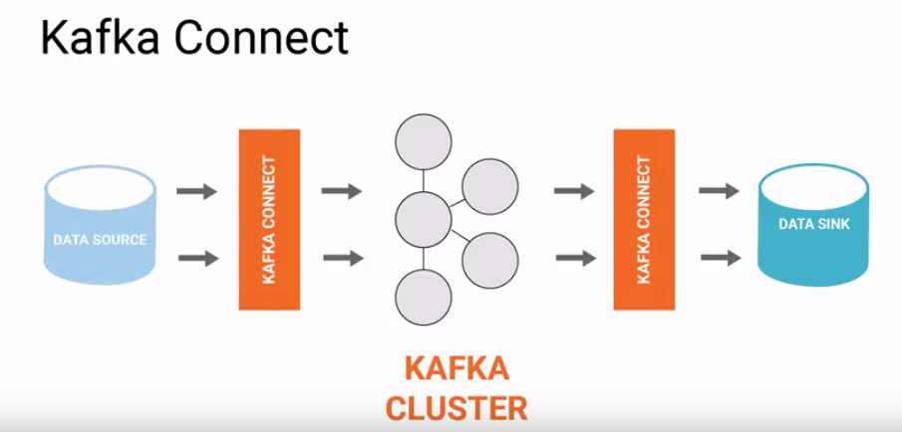
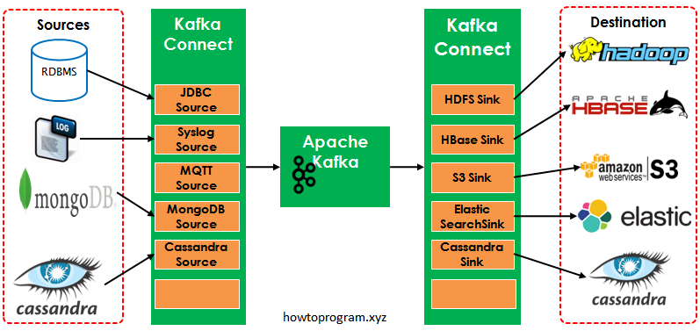
Kafka Connect – Bridging technologies
Kafka is the medium for persistence, distribution, orchestration, open interaction across dozens of technologies, vendors and locations
Declarative agents to read&produce (source) or consume&write (sink)
Connectors (140+) available on Confluent Hub
Community, Open Source, Commercial

Slide 32
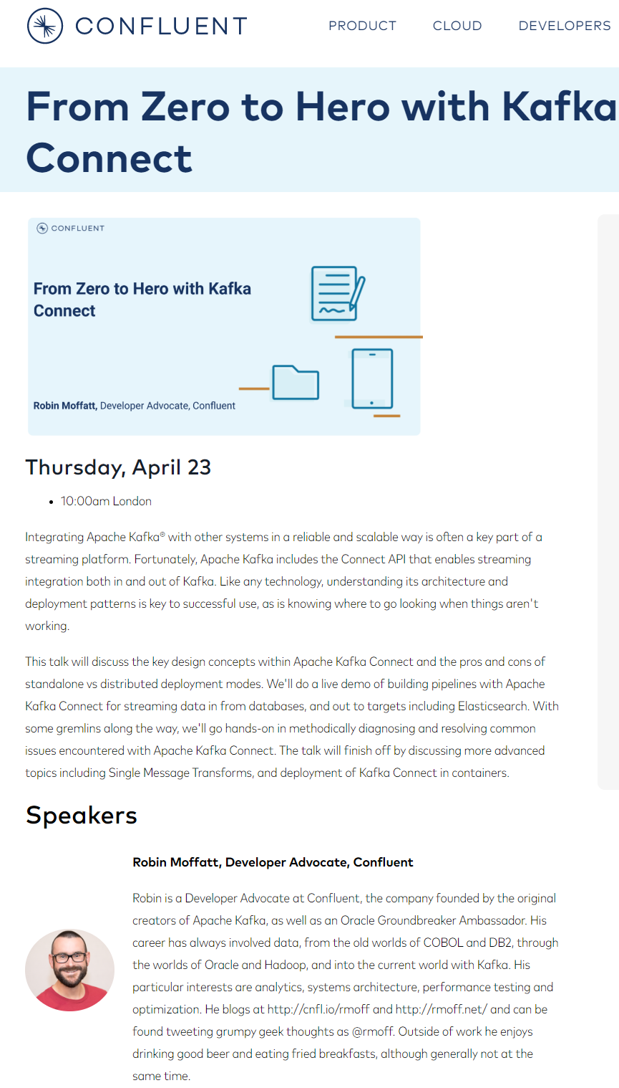
Kafka Connect Webinar – Morgenochtend (23 april) 11.00 uur
https://www.confluent.io/online-talks/from-zero-to-hero-with-kafka-connect
Notes:
https://www.confluent.io/online-talks/from-zero-to-hero-with-kafka-connect

Slide 33

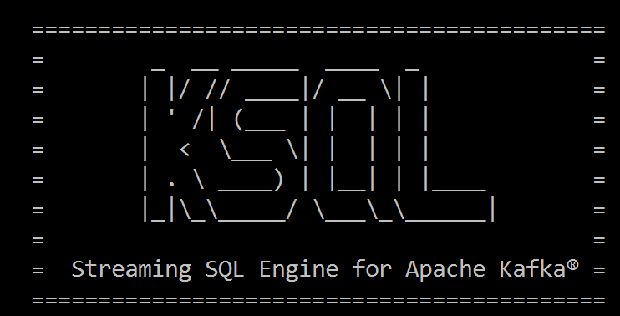
Select Running Count from <stream of tweet events>
select tag
, count(*) tweet_count from tweets Where tag = 'COVID2019' or tag = 'KAFKA'
group by tag
<--- streaming data

Slide 34

Continuous Queries on Streaming Data
Count Events, Aggregate Payloads, Filter, Combine & Enrich…
… and produce: new events
Topic
Processor
Topic
Topic
Processor
Topic
Table

Slide 35



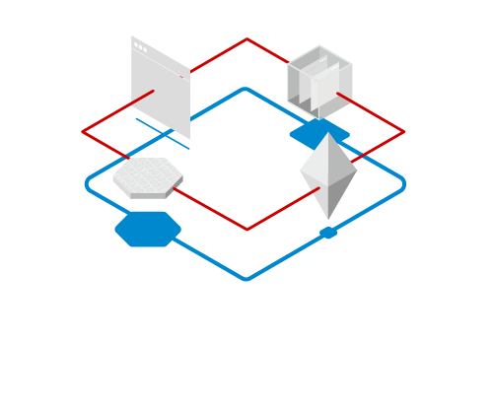
Alternatives for Apache Kafka’s Distributed Streaming Event Platform
Apache Pulsar
Solace PubSub+ Event Portal
Rabbit MQ
Apache Active MQ
RedHat AMQ
Streaming Data libraries
Apache Spark Streaming, Conduit, Faust, Apache Flink, Apache Storm, Samza, Apache Beam, Apache Flume, Apache NiFi

Slide 36
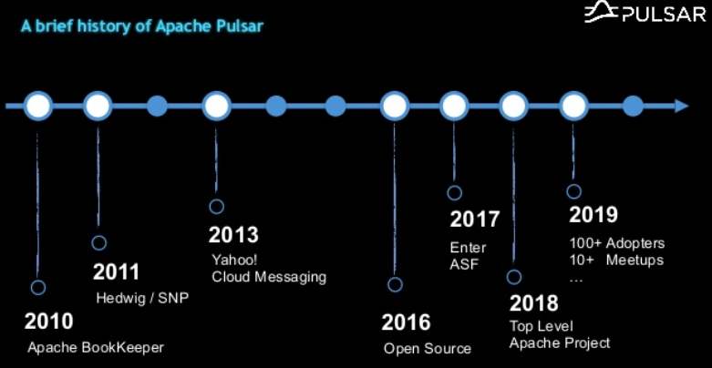
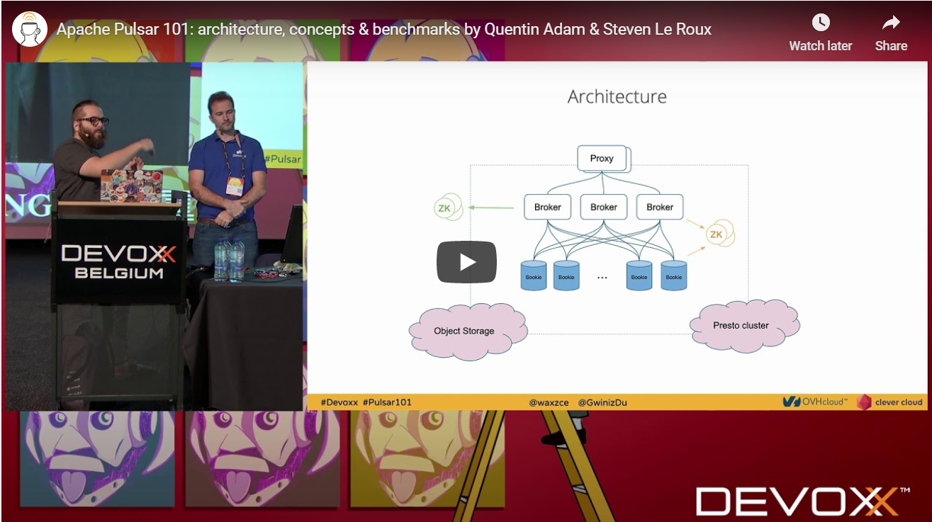
Apache Pulsar
Created at Yahoo – used for production for > three years (Ms msg/s)
Kafka orginated at LinkedIn (before 2011)
Making some waves at conferences recently
Notes:
https://devoxx.be/talk/?id=52363

Slide 37
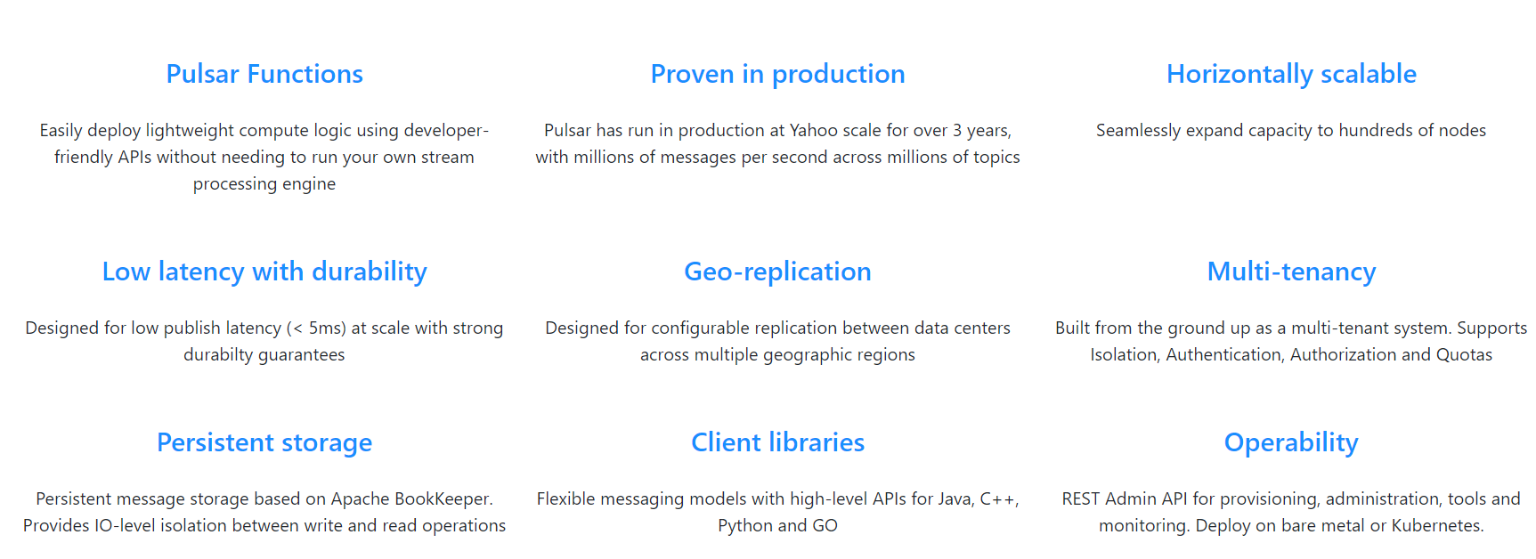
Apache Pulsar
Created at Yahoo – used for production for > three years (Ms msg/s)
Kafka orginated at LinkedIn (before 2011)

Slide 38
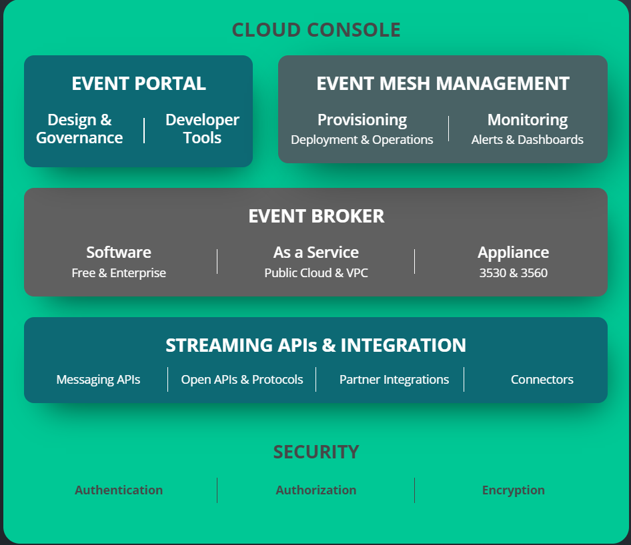
Solace PubSub+ and Event Portal
Event Broker and Event Mesh (network of Event Brokers)
Event Portal: Governance
Event Portal to design, manage and share event definitions (catalog)
Streaming APIs & Integration Connectors
Including Kafka Connector
Originating in Finance Industry
Since 2001
Generally Available: April 2020

Slide 39
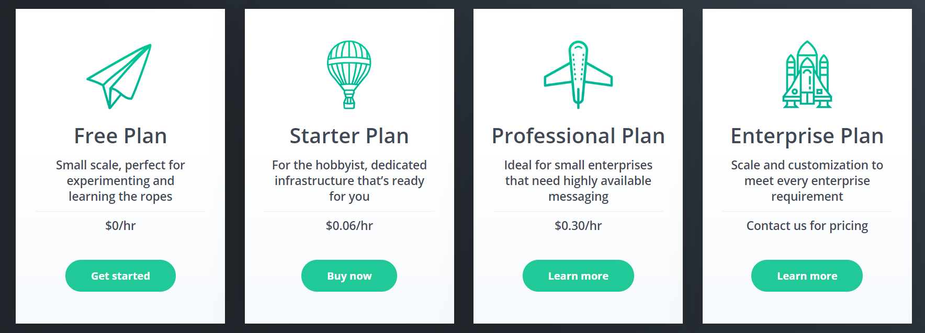
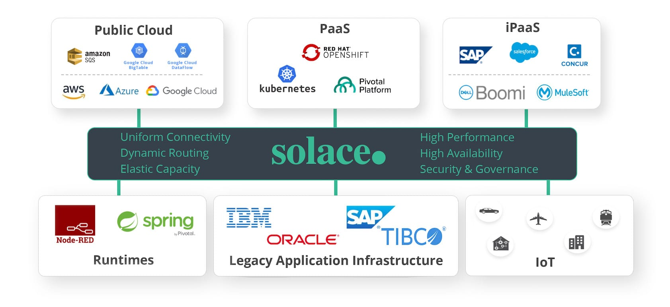
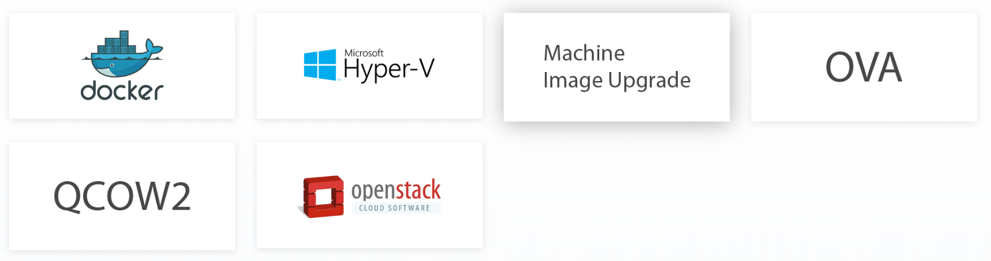
Solace PubSub+ and Event Portal
USPs (compared to Kafka):
Hierarchical topics and subscriptions that contain event filter
Message order per topic (actually: producer)
Fine Grained Access Control
On Prem and Cloud
Start for free
Public Cloud
On Prem & Private Cloud

Slide 40
Managed Kafka (-like) Cloud Offering
AWS
SQS
Managed Streaming for Apache Kafka (Amazon MSK)
EventBridge, Kinesis
Azure
Event Hub
EventGrid, Stream Analytics
Oracle Cloud Infrastructure
Streams
Google Cloud Platform
PubSub
DataFlow
… (Heroku Managed Kafka, Alibaba Cloud LogHub, IBM Event Streams,…)
?

Slide 41
Recap
http://etc.ch/QmfH

Slide 42

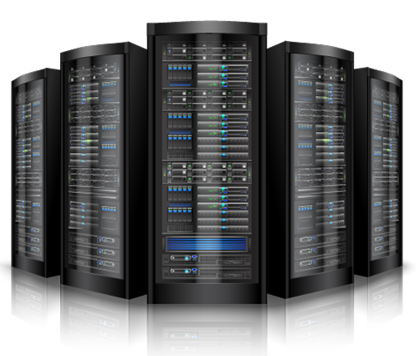

Summary
=> == =>
Apache Kafka is emerging as platform of choice for message exchange in a world of
Microservices
Event Sourcing, CQRS and Data Source Synchronization
Clouds
Fast Data (IoT) and Streaming Analysis
Real time data integration & distribution
Getting started with Apache Kafka is not very hard at all
The platform is open source – and has broad client support (Java, Node, …)
Many resources are available – tutorials, blog article, demonstrations, presentation slides and recordings of conference sessions, samples on GitHub
Using Docker Compose it is quite easy to quickly run a Kafka Cluster
Note: managing a production grade cluster is not so easy

Slide 43
Overview
What is Apache Kafka? Core concepts and technology
Lab 1 – First hands-on with Apache Kafka
Programming against Apache Kafka
Brief introduction of Node (JS)
Lab 2 – Programmatic interaction with Apache Kafka
Shades of Data – Streaming, CQRS, Event Sourcing
The Eneco Case – The Event Streaming Platform
Lab 3 – DIY CQRS
Microservices and the quest for decoupling
Lab 4 – Microservices Interaction and Choreography
But wait – there is more:
Schema Registry, Connect, Streams, KSQL
Pulsar, Solace, RabbitMQ and the Public Cloud Vendors: Azure Event Hub & Stream Analytics, OCI Streams, AWS MSK,

Slide 44

Lab 4
Billing Run Coordinator
1
Asynchronous conversation between microservices
Create bill processing instructions for customers
Handles assignment on workflow queue to produce a bill for a customer
2
workflow-queue
CRM
Billing Engine
6
questions
Generate bill as local file
3
answers
4
5
Consume Event, handle the question and publish a response with customer details on a second queue – including the conversation identifier
Consume and correlate answer from Kafka Topic – continue processing the bill
Publish Event to Kafka Topic with question details and conversation identifier

Slide 45
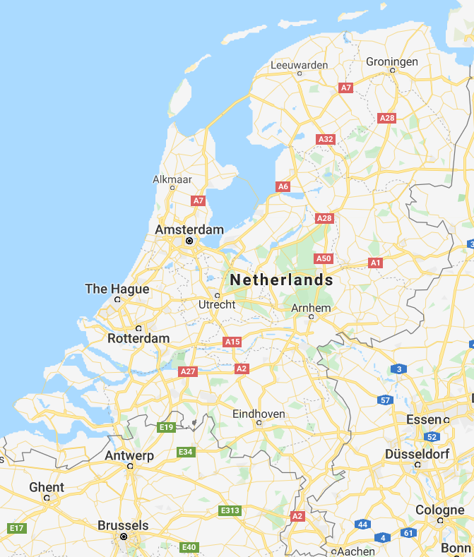

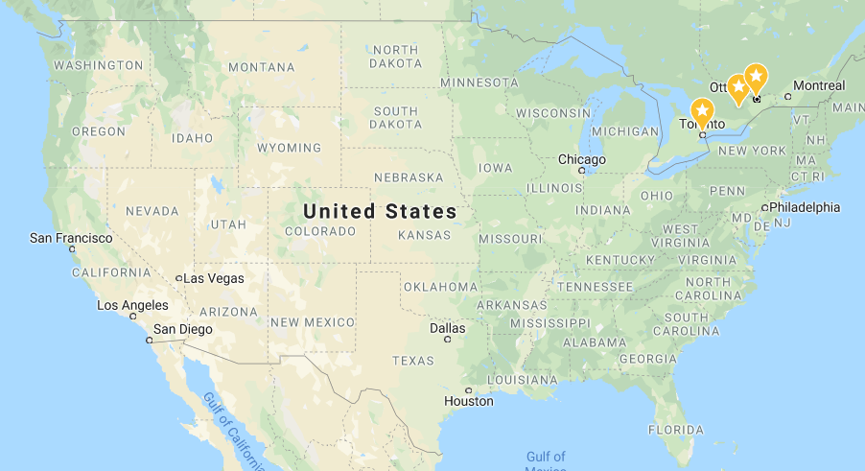

Demo Lab 4 – Een pas-de-trois op ruime afstand
Rene’s Laptop
Dordrecht
Maarten’s Laptop
Lucas’ Laptop

Slide 46
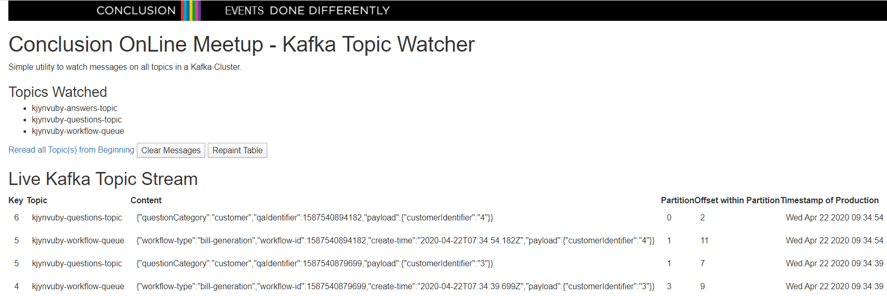
Demo Lab 4 – Een pas-de-trois op ruime afstand
HTTP POST – Request bills for one or more customers
1
Billing Run Coordinator
HTTP POST – Create a new customer
Rene’s Laptop
workflow-queue
CRM
2
Billing Engine
4
questions
3
6
5
answers
Maarten’s Laptop
Lucas’ Laptop

Slide 47
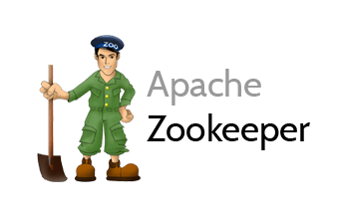
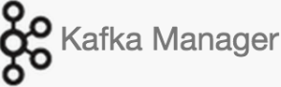


Extended Lab Environment – from docker-compose.yml => docker-compose-full-kafka-stack.yml
2181
9092
9093
9094
Docker Compose
kafka
28044
28042
Browser
Laptop
localhost

Slide 48
Extended Lab Environment – docker-compose-full-kafka-stack.yml
Schema Registry
Kafka Connect 2
2181
Kafka Connect 1
KSQL DB Server
9092
9093
9094
Docker Compose
Kafka Connect UI
Schema Registry UI
KSQL CLI
kafka
28044
28042
28038
28039
Browser
Laptop
localhost

Slide 49
Follow-Up Sessions
Streaming Analytics – Kafka Streams & KSQL
Kafka Connect – Source and Sink Adapters
Debezium and Kafka Connect – Change Data Capture
Exploring Kafka look-alikes
Apache Pulsar, RabbitMQ, Solace
Exploring Public Cloud offerings for Streaming Events
AWS SQS and EventBridge & Kinesis
Azure Event Hub and Stream Analytics
Google PubSub and DataFlow
…
Microservice Choreography & modern business process management

Slide 50
Next steps
http://etc.ch/QmfH

Slide 51

Twee aanstaande Conclusion OnLine Meetup Sessies
Dinsdag 28 april – 17.00-18.00 uur – Meinout Koomen Intro van Azure Monitoring & Log Analytics - meten is weten
Azure Application Insight, Log Analytics, Monitoring
Detecteren, analyseren, rapporteren (en voorkomen), dashboard inrichting en alarm-configuratie, hybride cloud ⬄ on prem, demo
Donderdag 30 april – 17.00-18.00 uur – Tomasz Brzezinski Picking the right Service for Integration, Workflow Orchestration and other Automation Tasks on Azure – what, when, how?
LogicApps, Function Apps, Power Automate (fka Flow), Web Jobs
Serverless, low code, microservice, IoT, business process orchestration, total cost of ownership, coding
Link
Link
En vanaf begin mei: Code Café Online

Slide 52


Thank you for your attention I hope this was useful
lucas.jellema@amis.nl | technology.amis.nl | @lucasjellema | lucas-jellema

